Slide 1
William Stallings
Data and Computer Communications
7th Edition
Chapter 12
Routing

Slide 2
Routing in Circuit Switched Network
Many connections will need paths through more than one switch
Need to find a route
  Efficiency
  Resilience
Public telephone switches are a tree structure
  Static routing uses the same approach all the time
Dynamic routing allows for changes in routing depending on traffic
  Uses a peer structure for nodes

Slide 3
Alternate Routing
Possible routes between end offices predefined
Originating switch selects appropriate route
Routes listed in preference order
Different sets of routes may be used at different times

Slide 4
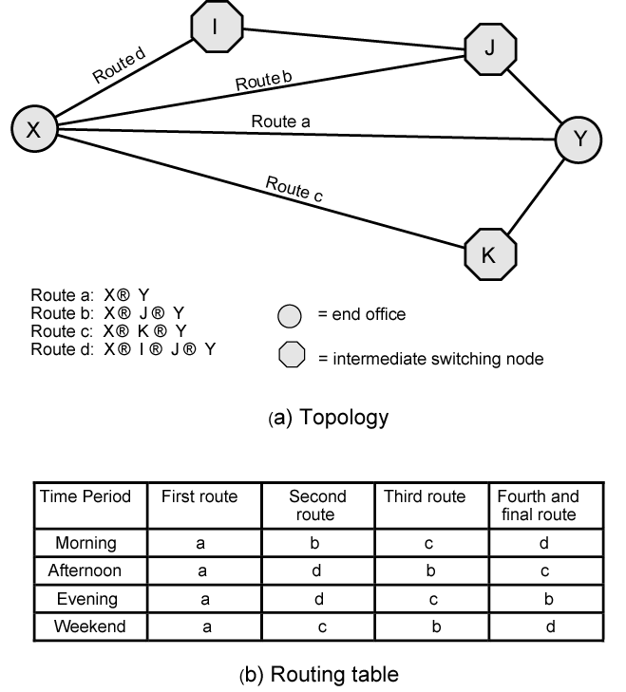
Alternate
Routing
Diagram

Slide 5
Routing in Packet Switched Network
Complex, crucial aspect of packet switched networks
Characteristics required
  Correctness
  Simplicity
  Robustness
  Stability
  Fairness
  Optimality
  Efficiency

Slide 6
Performance Criteria
Used for selection of route
Minimum hop
Least cost
  See Stallings appendix 10A for routing algorithms

Slide 7
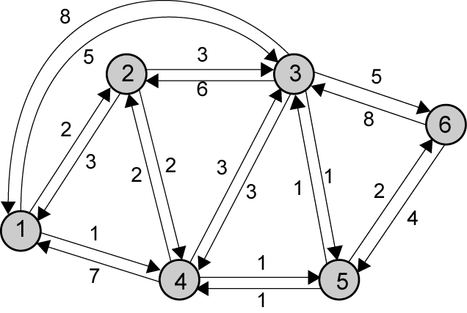
Example Packet Switched Network

Slide 8
Decision Time and Place
Time
  Packet or virtual circuit basis
Place
  Distributed
    Made by each node
  Centralized
  Source

Slide 9
Network Information Source and Update Timing
Routing decisions usually based on knowledge of network (not always)
Distributed routing
  Nodes use local knowledge
  May collect info from adjacent nodes
  May collect info from all nodes on a potential route
Central routing
  Collect info from all nodes
Update timing
  When is network info held by nodes updated
  Fixed - never updated
  Adaptive - regular updates

Slide 10
Routing Strategies
Fixed
Flooding
Random
Adaptive

Slide 11
Fixed Routing
Single permanent route for each source to destination pair
Determine routes using a least cost algorithm (appendix 10A)
Route fixed, at least until a change in network topology

Slide 12
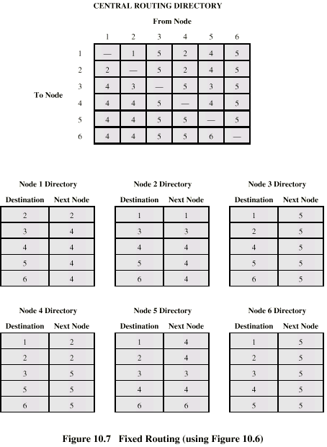
Fixed Routing
Tables

Slide 13
Flooding
No network info required
Packet sent by node to every neighbor
Incoming packets retransmitted on every link except incoming link
Eventually a number of copies will arrive at destination
Each packet is uniquely numbered so duplicates can be discarded
Nodes can remember packets already forwarded to keep network load in bounds
Can include a hop count in packets

Slide 14
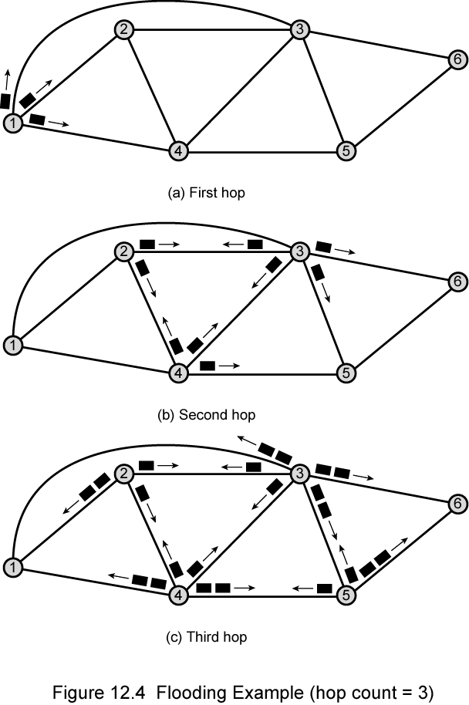
Flooding
Example

Slide 15
Properties of Flooding
All possible routes are tried
  Very robust
At least one packet will have taken minimum hop count route
  Can be used to set up virtual circuit
All nodes are visited
  Useful to distribute information (e.g. routing)

Slide 16
Random Routing
Node selects one outgoing path for retransmission of incoming packet
Selection can be random or round robin
Can select outgoing path based on probability calculation
No network info needed
Route is typically not least cost nor minimum hop

Slide 17
Adaptive Routing
Used by almost all packet switching networks
Routing decisions change as conditions on the network change
  Failure
  Congestion
Requires info about network
Decisions more complex
Tradeoff between quality of network info and overhead
Reacting too quickly can cause oscillation
Too slowly to be relevant

Slide 18
Adaptive Routing - Advantages
Improved performance
Aid congestion control (See chapter 13)
Complex system
  May not realize theoretical benefits

Slide 19
Classification
Based on information sources
  Local (isolated)
    Route to outgoing link with shortest queue
    Can include bias for each destination
    Rarely used - do not make use of easily available info
  Adjacent nodes
  All nodes

Slide 20
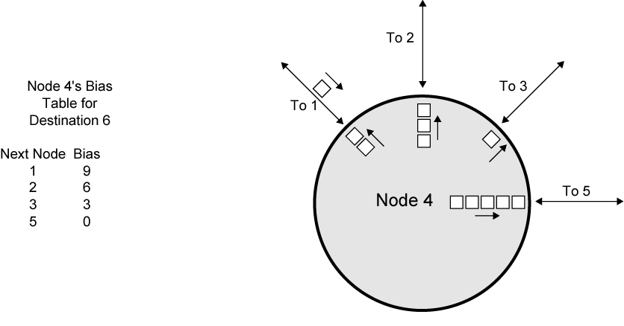
Isolated Adaptive Routing

Slide 21
ARPANET Routing Strategies(1)
First Generation
  1969
  Distributed adaptive
  Estimated delay as performance criterion
  Bellman-Ford algorithm (appendix 10a)
  Node exchanges delay vector with neighbors
  Update routing table based on incoming info
  Doesn't consider line speed, just queue length
  Queue length not a good measurement of delay
  Responds slowly to congestion

Slide 22
ARPANET Routing Strategies(2)
Second Generation
  1979
  Uses delay as performance criterion
  Delay measured directly
  Uses Dijkstra’s algorithm (appendix 10a)
  Good under light and medium loads
  Under heavy loads, little correlation between reported delays and those experienced

Slide 23
ARPANET Routing Strategies(3)
Third Generation
  1987
  Link cost calculations changed
  Measure average delay over last 10 seconds
  Normalize based on current value and previous results

Slide 24
Least Cost Algorithms
Basis for routing decisions
  Can minimize hop with each link cost 1
  Can have link value inversely proportional to capacity
Given network of nodes connected by bi-directional links
Each link has a cost in each direction
Define cost of path between two nodes as sum of costs of links traversed
For each pair of nodes, find a path with the least cost
Link costs in different directions may be different
  E.g. length of packet queue

Slide 25
Dijkstra’s Algorithm Definitions
Find shortest paths from given source node to all other nodes, by developing paths in order of increasing path length
N = set of nodes in the network
s = source node
T = set of nodes so far incorporated by the algorithm
w(i, j) = link cost from node i to node j
  w(i, i) = 0
  w(i, j) = ∞ if the two nodes are not directly connected
  w(i, j) ≥ 0 if the two nodes are directly connected
L(n) = cost of least-cost path from node s to node n currently known
  At termination, L(n) is cost of least-cost path from s to n

Slide 26
Dijkstra’s Algorithm Method
Step 1 [Initialization]
  T = {s} Set of nodes so far incorporated consists of only source node
  L(n) = w(s, n) for n ≠ s
  Initial path costs to neighboring nodes are simply link costs
Step 2 [Get Next Node]
  Find neighboring node not in T with least-cost path from s
  Incorporate node into T
  Also incorporate the edge that is incident on that node and a node in T that contributes to the path
Step 3 [Update Least-Cost Paths]
  L(n) = min[L(n), L(x) + w(x, n)] for all n ∉ T
  If latter term is minimum, path from s to n is path from s to x concatenated with edge from x to n
Algorithm terminates when all nodes have been added to T

Slide 27
Dijkstra’s Algorithm Notes
At termination, value L(x) associated with each node x is cost (length) of least-cost path from s to x.
In addition, T defines least-cost path from s to each other node
One iteration of steps 2 and 3 adds one new node to T
  Defines least cost path from s tothat node

Slide 28
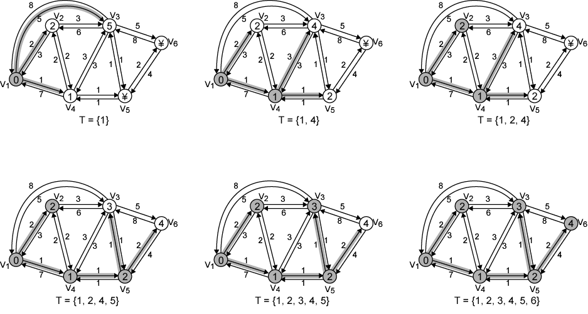
Example of Dijkstra’s Algorithm

Slide 29
Results of Example
Dijkstra’s Algorithm
Iteration | T | L(2) | Path | L(3) | Path | L(4) | Path | L(5) | Path | L(6) | Path
1 | {1} | 2 | 1–2 | 5 | 1-3 | 1 | 1–4 | ∞ | - | ∞ | -
2 | {1,4} | 2 | 1–2 | 4 | 1-4-3 | 1 | 1–4 | 2 | 1-4–5 | ∞ | -
3 | {1, 2, 4} | 2 | 1–2 | 4 | 1-4-3 | 1 | 1–4 | 2 | 1-4–5 | ∞ | -
4 | {1, 2, 4, 5} | 2 | 1–2 | 3 | 1-4-5–3 | 1 | 1–4 | 2 | 1-4–5 | 4 | 1-4-5–6
5 | {1, 2, 3, 4, 5} | 2 | 1–2 | 3 | 1-4-5–3 | 1 | 1–4 | 2 | 1-4–5 | 4 | 1-4-5–6
6 | {1, 2, 3, 4, 5, 6} | 2 | 1-2 | 3 | 1-4-5-3 | 1 | 1-4 | 2 | 1-4–5 | 4 | 1-4-5-6

Slide 30
Bellman-Ford Algorithm Definitions
Find shortest paths from given node subject to constraint that paths contain at most one link
Find the shortest paths with a constraint of paths of at most two links
And so on
s = source node
w(i, j) = link cost from node i to node j
  w(i, i) = 0
  w(i, j) = ∞ if the two nodes are not directly connected
  w(i, j) ≥ 0 if the two nodes are directly connected
h = maximum number of links in path at current stage of the algorithm
L_{h}(n) = cost of least-cost path from s to n under constraint of no more than h links

Slide 31
Bellman-Ford Algorithm Method
Step 1 [Initialization]
  L₀(n) = ∞, for all n ≠ s
  L_{h}(s) = 0, for all h
Step 2 [Update]
For each successive h ≥ 0
  For each n ≠ s, compute
  L_{h+1}(n)=^{min}_{j}[L_{h}(j)+w(j,n)]
Connect n with predecessor node j that achieves minimum
Eliminate any connection of n with different predecessor node formed during an earlier iteration
Path from s to n terminates with link from j to n

Slide 32
Bellman-Ford Algorithm Notes
For each iteration of step 2 with h=K and for each destination node n, algorithm compares paths from s to n of length K=1 with path from previous iteration
If previous path shorter it is retained
Otherwise new path is defined

Slide 33
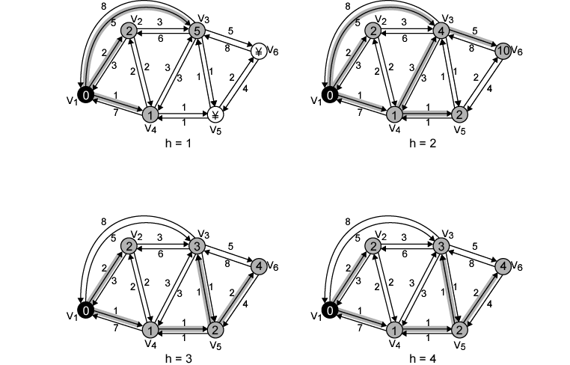
Example of Bellman-Ford Algorithm

Slide 34
Results of Bellman-Ford Example
h | L_{h}(2) | Path | L_{h}(3) | Path | L_{h}(4) | Path | L_{h}(5) | Path | L_{h}(6) | Path
0 | ∞ | - | ∞ | - | ∞ | - | ∞ | - | ∞ | -
1 | 2 | 1-2 | 5 | 1-3 | 1 | 1-4 | ∞ | - | ∞ | -
2 | 2 | 1-2 | 4 | 1-4-3 | 1 | 1-4 | 2 | 1-4-5 | 10 | 1-3-6
3 | 2 | 1-2 | 3 | 1-4-5-3 | 1 | 1-4 | 2 | 1-4-5 | 4 | 1-4-5-6
4 | 2 | 1-2 | 3 | 1-4-5-3 | 1 | 1-4 | 2 | 1-4-5 | 4 | 1-4-5-6

Slide 35
Comparison
Results from two algorithms agree
Information gathered
  Bellman-Ford
    Calculation for node n involves knowledge of link cost to all neighboring nodes plus total cost to each neighbor from s
    Each node can maintain set of costs and paths for every other node
    Can exchange information with direct neighbors
    Can update costs and paths based on information from neighbors and knowledge of link costs
  Dijkstra
    Each node needs complete topology
    Must know link costs of all links in network
    Must exchange information with all other nodes

Slide 36
Evaluation
Dependent on processing time of algorithms
Dependent on amount of information required from other nodes
Implementation specific
Both converge under static topology and costs
Converge to same solution
If link costs change, algorithms will attempt to catch up
If link costs depend on traffic, which depends on routes chosen, then feedback
  May result in instability

Slide 37
Required Reading
Stalling Chapter 12
Routing information from Comer D. Internetworking with TCP/IP Volume 1, Prentice Hall, Upper Saddle River NJ.

